Slide 1
Analysis of online Google store customer dataset
Tobel Ezeokoli
Chen Pan

Slide 2
Executive Summary
An increasingly complex – and more volatile – consumer behavior presents changes and challenges that have altered the context in which companies must undertake planning its marketing and operation budget.
External changes: Given the lack of stability and predictability in the ecommerce, companies have to learn to be agile and adaptable as possible. Our approach is conduct an analysis to figure out the purchasing behaviour of our clients.
Internal Changes: Internal obstacles to allocate resources include strained resources and budgets; Our approach to this is to figure out traffic conducted by each customer group and provide insights and recommendations on how to spend our budget accordingly.
Notes:
Google store wants to figure out why there’s always fluctuations on sales and how to increse their profit. and External reasons is that there’re too many competitors domestically and internationally. And also we have this cutural, political concerns when entering a new markets since we don’t know much about the local market. And also we have limited budget, that’s why we have to reasonably allocating our resources, interms of marketing campaign and maintennece of our database.We are conducting an analysis based on consumer behaviour, internal transaction data, external data like deomographoc s.

Slide 3
Research Objectives
The 80/20 rule has proven true for many businesses–only a small percentage of customers produce most of the revenue. As such, marketing teams are challenged to make appropriate investments in promotional strategies.
Goal: To analyse a Google Merchandise store customer dataset to inform operational and marketing decisions for the company.
Notes:
Based on our current customers on80% customers are from 20% of population. we need to figure out who are they, where are they, what are they purchashing and either converting customers who are not purcashing from us into “good customer.” Or we should enter a market that has potential to get more good customers. And if we’ve decided to enter a new market, how can we do that.

Slide 4
The principles for Effective planning and allocating resources
Identify profitable customers
Figure out the best timing and dates
Access new Customers through different channels
Try to convert customers
Customer retention
Identify and quantify cost in a measurable way
Invest in customers have the best potential based on cost-benefit analysis
Get rid of fragmented part
Notes:
The way we recommend for future resource and budget allocation is that, for current clients, we are doing an P and L analysis. Basically comparing the Revenue and cost. Also, we noticed that there’re couple places have the potential so we probably should enter those markets as well. Give that to Tobel.

Slide 5
Database considerations
Meets business goals - OLAP database; analysis and reporting (dimensions/measures, star dimensional model)
Sufficient and relevant dimensions\facts
Data privacy (no personal or sensitive data)
Data integrity; primary and foreign key constraints, limits
Data consistency (missing and redundant data)
Convenient to use; use of indexes for speed, simple column names and tables
Notes:
There were some of the factors that we felt were relevant while choosing and designing our database
Meeting business goals was very key for our analysis, like pamela stated, our primary goal here is to analyze Google store’s customer dataset to inform their marketing and budgeting process
In order to ensure that our data analysis would be effective and useful to our client, we had to make sure we had sufficient and relevant dimensions and information
Another consideration for us was data privacy, made sure our database had any personal or sensitive information, no customers’ rights were being infringed
For our analysis, we envisioned our database having multiple relationships among the entities so enforcing data and relational integrity was also key for us

Slide 6
Data preparation & Ingestion
Source: Kaggle dataset
Tools: R platform, Excel application, MySQL workbench
Methods: 3NF normalization, SQL DDL
Output: Relational and star dimensional models

Slide 7
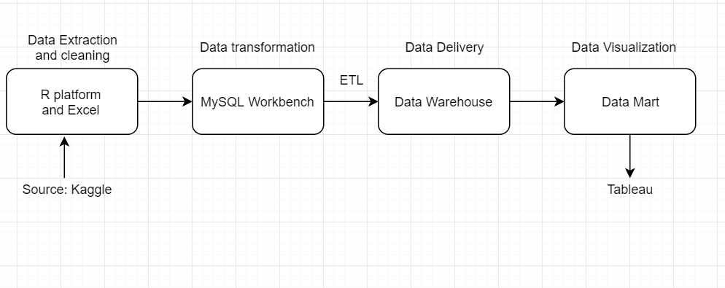
Process
Notes:
Like i mentioned in the previous slide, our source was a kaggle dataset but it was in json format. So we had to pull the data into r and clean it and then transform it into a csv format. While in csv format, we loaded the data in excel to do a bit more data cleaning and normalize the data into a relational database. Here, we also got rid of irrelevant columns and data. To ensure data consistency, we had to deal with blank data. Unfortunately, some of the relevant fields had missing values so a way we dealt with that was to assign a value to the foreign keys which had missing values which would connect to “Not Available” in the parent table.
Created the schema, added constraints to the tables to ensure data integrity.
Because we wanted to eventually analyze the data visually, we transformed the data into a dimensional model using SQL and then connected our tableau to our SQL database to analyze the data

Slide 8
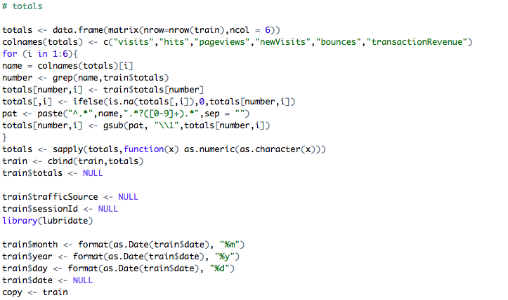
Data cleaning

Slide 9
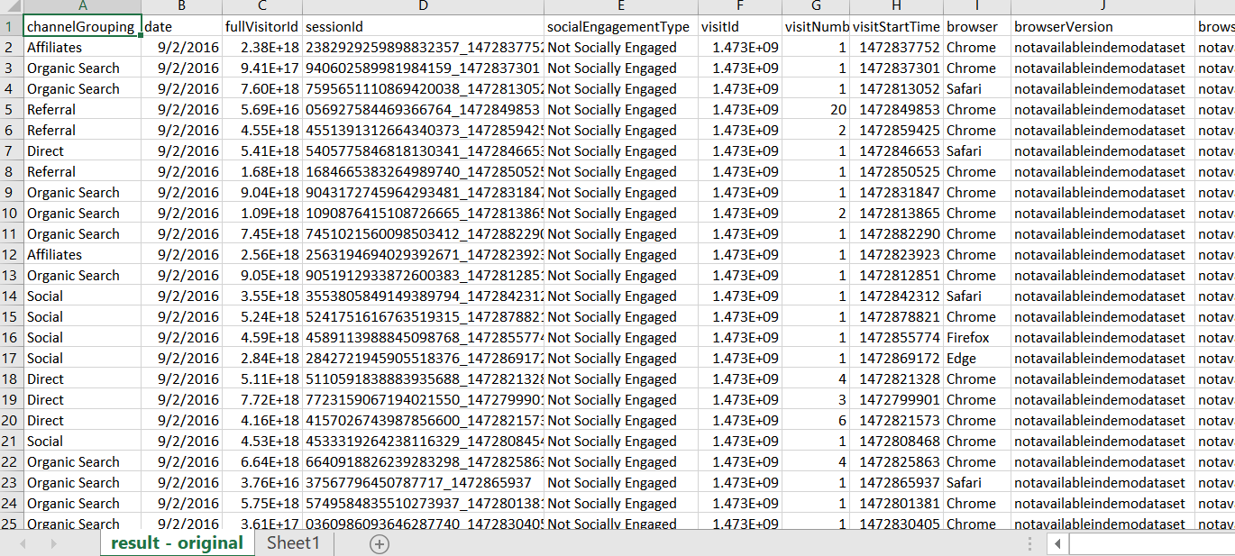
Unnormalized data

Slide 10
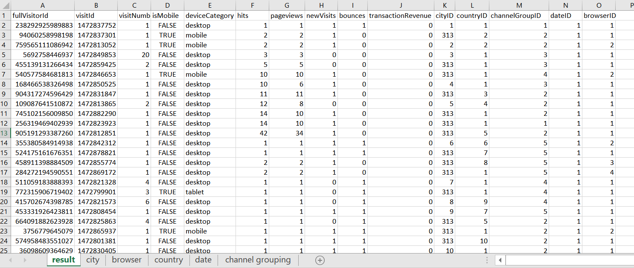
3NF Normalized data

Slide 11
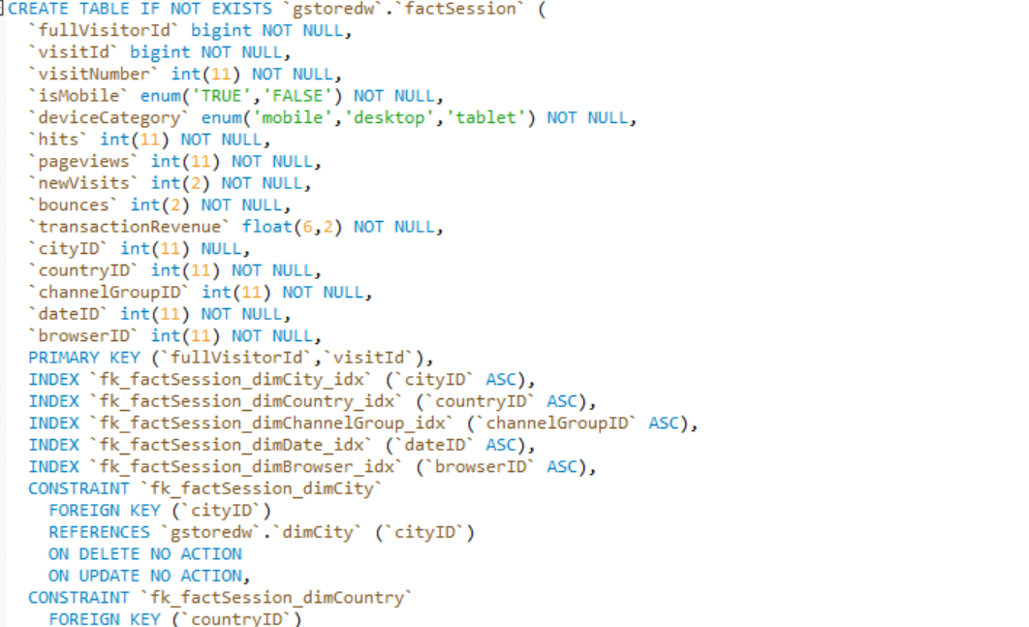
Data integrity
Notes:
Data integrity: limits, data type
Primary keys: not null
Foreign keys: update and delete

Slide 12
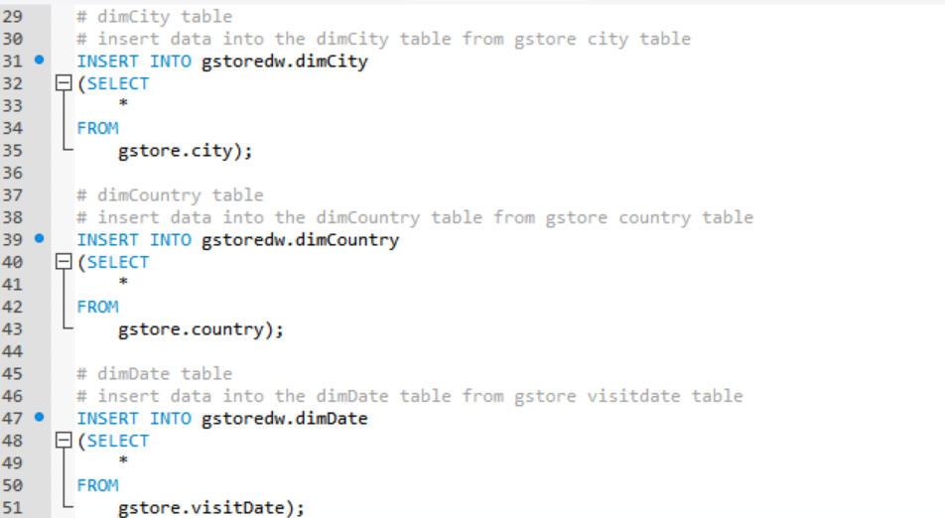
ETL process

Slide 13
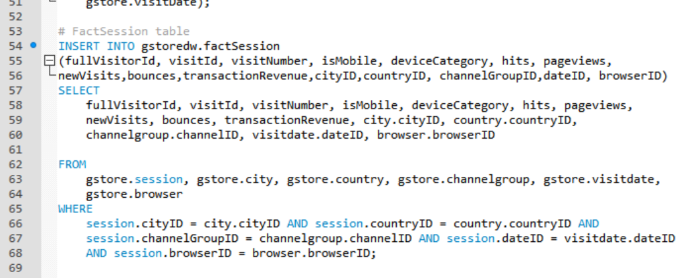
ETL process

Slide 14
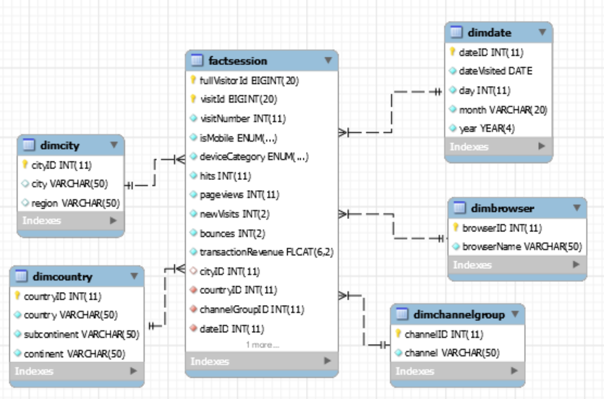
Star Dimensional Model

Slide 15
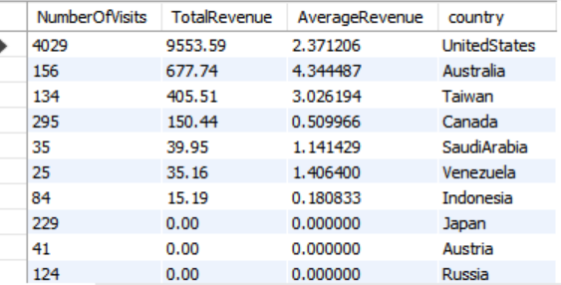
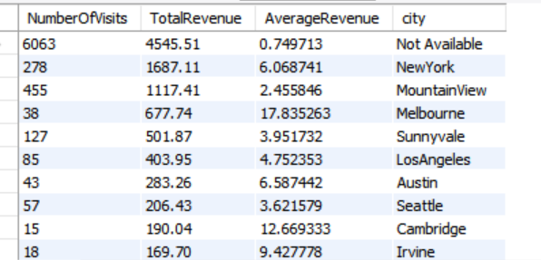
Data analysis
Get 10 countries with highest transaction revenue as well as the number of visits and average transaction amount
Get 10 cities with highest transaction revenue as well as the number of visits and average transaction amount

Slide 16
Customer Info and Segmentation
Segmentations: By country, channel, browser, date, etc
Behaviour difference: High expenditure in US, not so much in other countries
Recommendations: 1. Increase marketing budget in some countries 2.Further investigation in comp landscope 3.Provide delivery or other services if possible 4. Try customer acquisition in an effective way (depends on the country) 5. Decrease current spending with some of the countries.

Slide 17
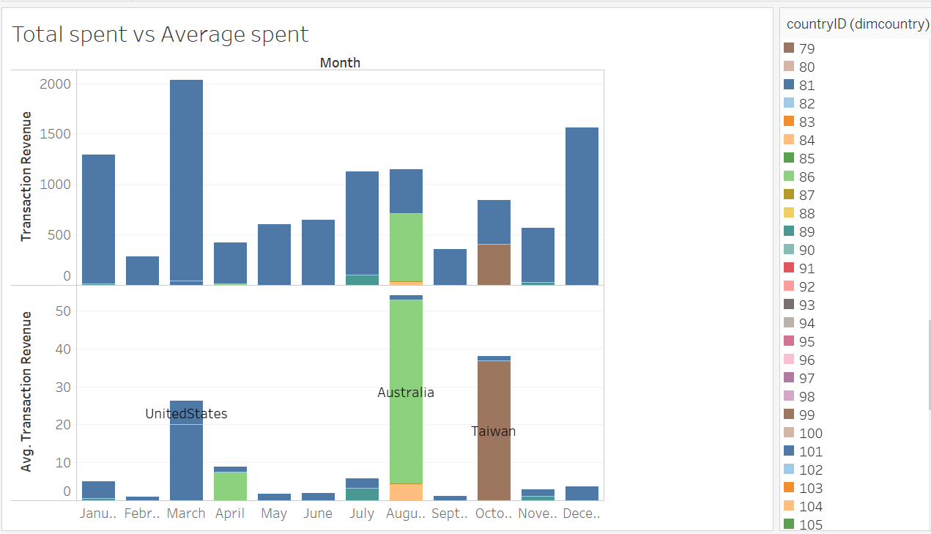
Notes:
In terms of total sales,we can see from the fisrt graph. blue stands for US and we can see that they’ve purchased from us all the time. Sales and aus and taiwan peaks in certain month, probably for big holiday. The second graph showed the average spending per person. And even tough sum of revenue is high in the us, we can see average expenditure per se is higher in aus and taiwan. So I think we have good customers there. But not too many of them in terms of population. So they have this good market potential. We should further coduct marketig analysis towards customers in those places. This leaves us another question: people in other countries don’t purchase from us bc they don’t know we have an online store or bc they know, but they don’t want to?

Slide 18
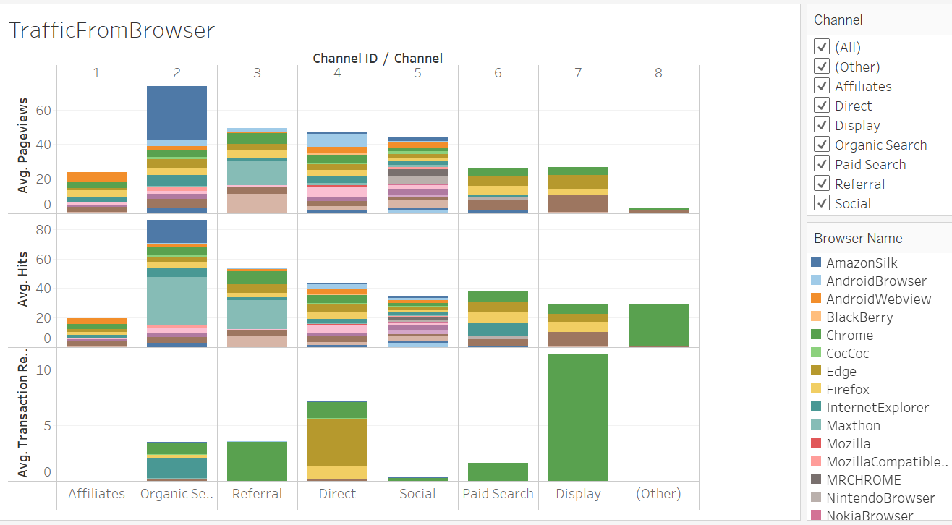
Notes:
Color stands for different browser, I’m counting the pageviews and hits we are gettng are from everywhere by channel. So we can see. These are the traffic that we have and reveneue we;re getting. The green box stands for chrome. On average, chrome gave us the medium search traffic, but appearently the highest average purchase per person. We can also divide that by country to investigate more.

Slide 19
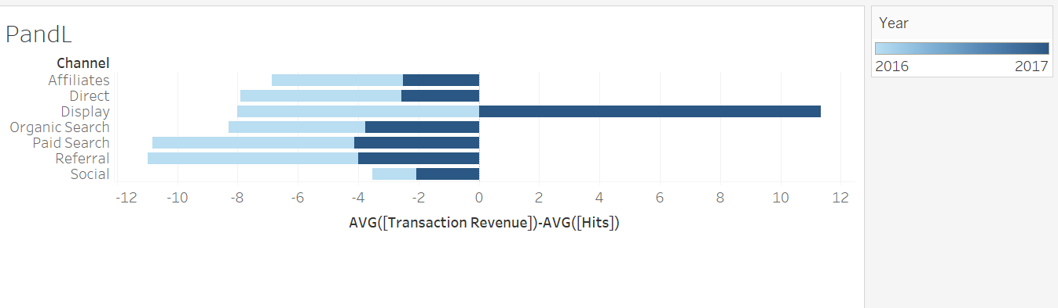
Data Analysis
Notes:
This is revenue - cost,light blue stadnds for 2016 and dark blue is 2017. We obviously have made progress in 2017 and expecting growth in 2018. And we are inveting in paid search and referral a lot. But we noticed from the previous slide that most profitable customers come from display and referral. So we should invest more resources in paid search.

Slide 20
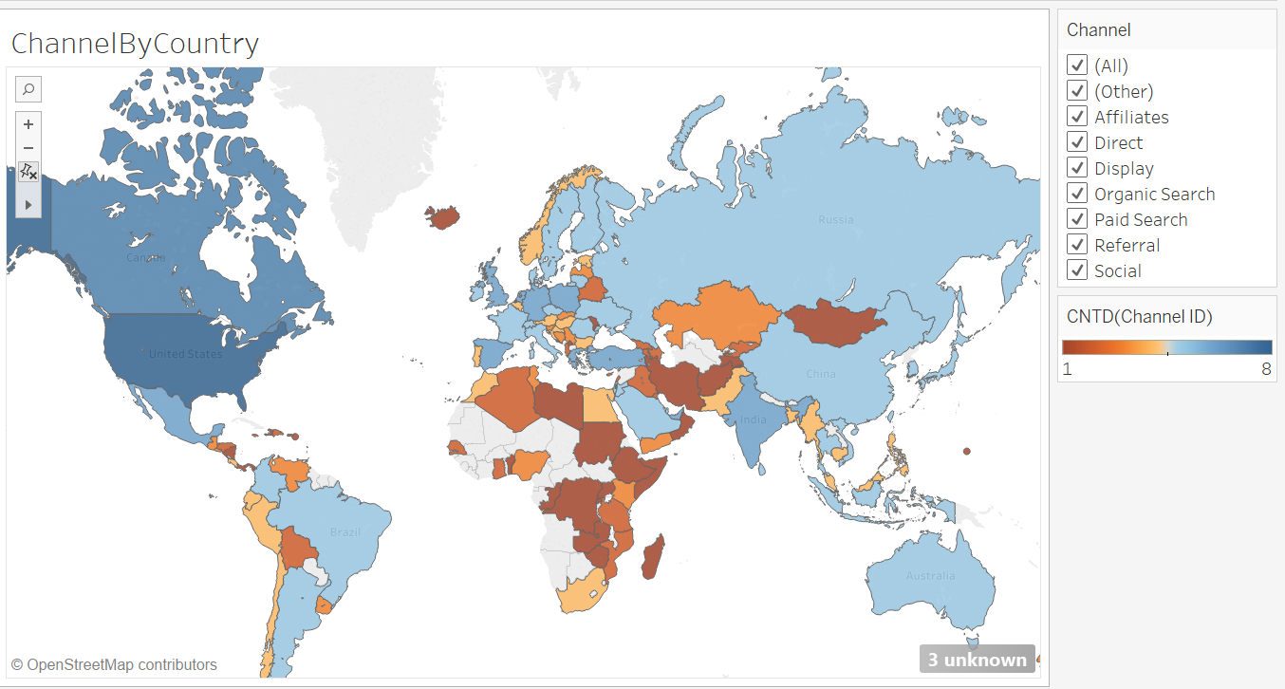
Notes:
Hypothesis: Internet / store not available? Other competitors? Result: Some are because of comp, some are because of availability. If comp already, probably adjust the prices on our products so we can be competitive or we should cut our budget in those countries and exit. In those countries we haven’t spend much budget, we should do a simple analysis to see if it’s doable.

Slide 21
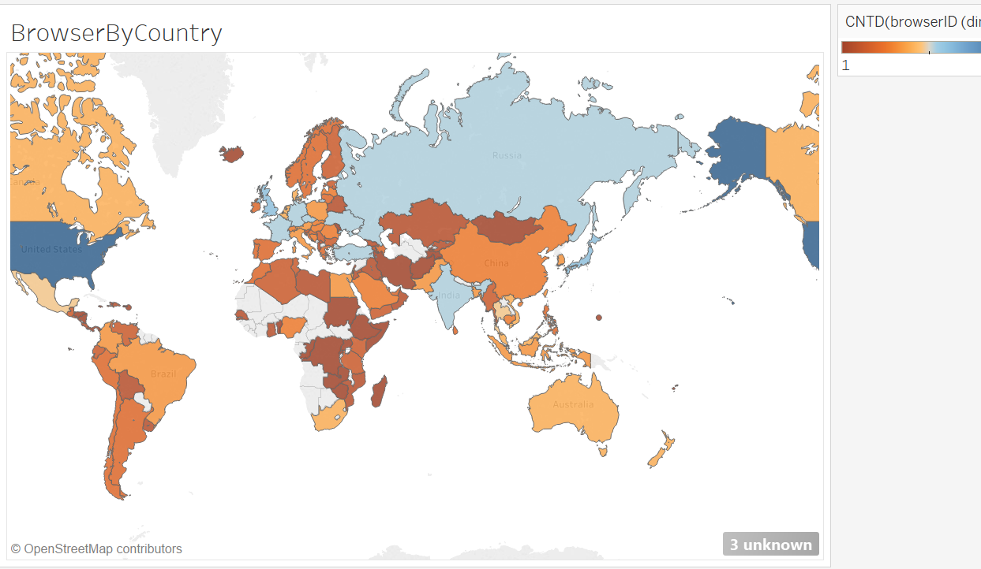
Notes:
To enter those market, we have to figure out how to do that. Apearently, they’re using alomost the same type of cell phone and browser. Then our web design in those countries should address that.

Slide 22
Recommendations
Important customers: by country; browser
New customers acquisition: Potential impact (demo data)
Ways to solve it: A/B test (Start with countries more like “US”)
Customer retention: Potential benefit (Average transaction/ frequency of purchase)
Converting customers (Provide extra service, different product, adjust price, launch new marketing campaign)
Problematic customers: High competitive; Not access to main products;
Reasoning: transaction and cost;
Options: 1.Investment in marketing and IT (After AB test)
2. Change current product or add more service depending on the strategy
3. Get rid of some of the customers and cut budget, depending on the info of comp and other demo index. A/B test for double check.
4.Getting local sales team or distribution channel

